Slide 1
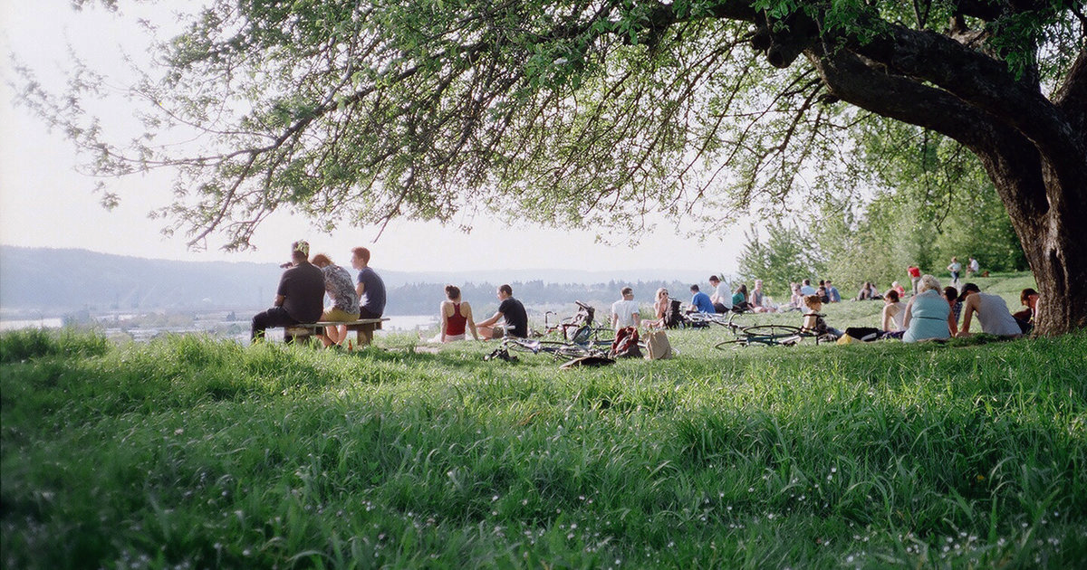
The Rec
Kevin Kong
Tim Newman
Nick Ryan
Gabriel Marquez
Camron Dennler
Michael Maramba
CSC 308 - 01/02

Slide 2

Description
For this project, our lab group has decided to design a web application that would recommend different activities to do around the central coast.
High level Functions of the system would Include:
An event log to display current events happening in the area
A scheduler so users can fit events into their schedules
Google map integration
User recommendations
System recommendations
Event submission panel
Event registration
Notes:
Gabriel

Slide 3
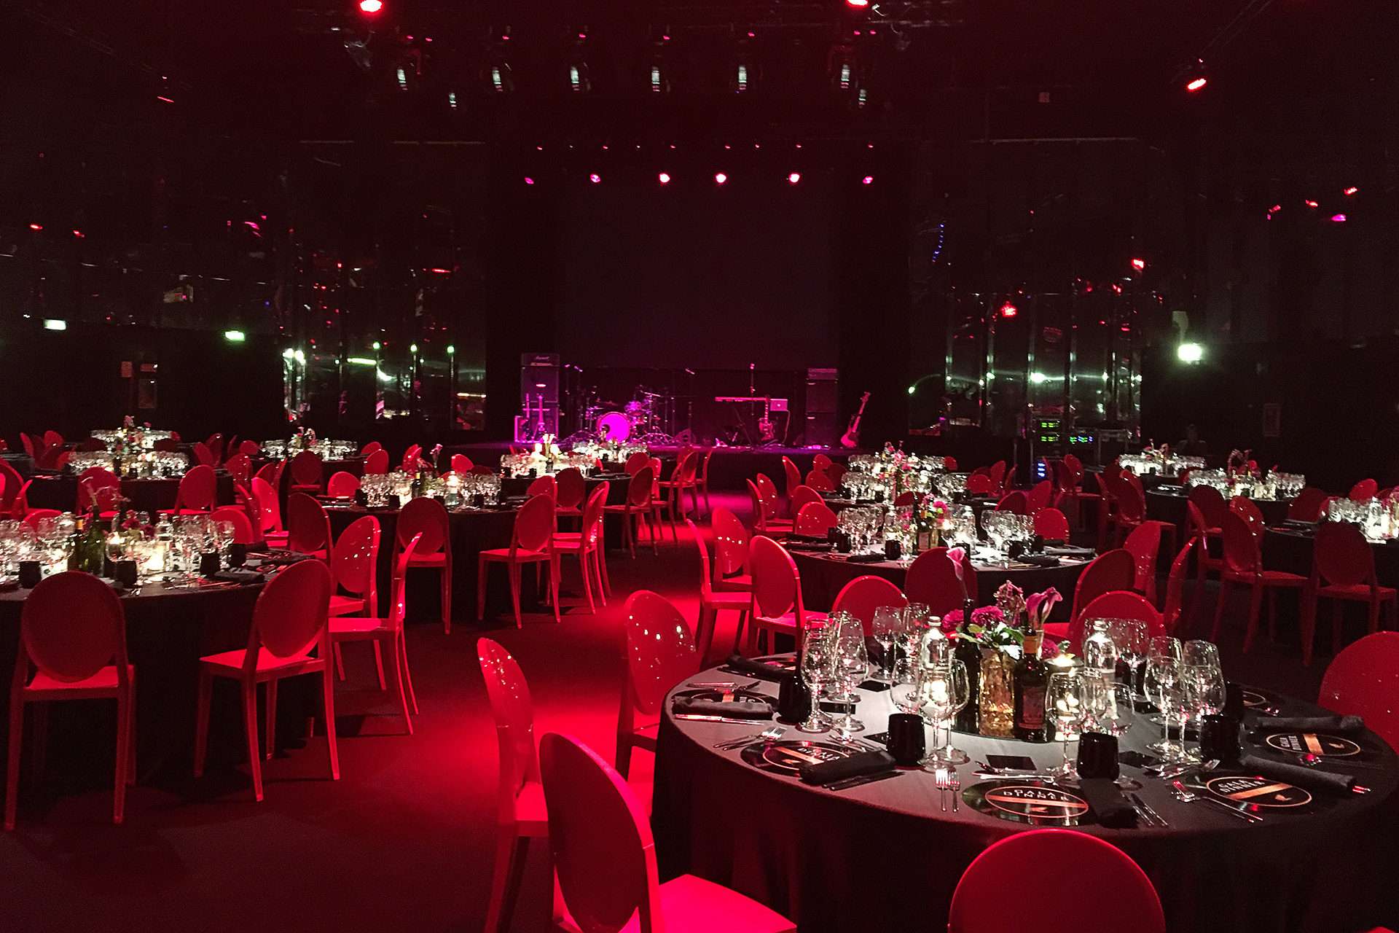
Glossary
Consumers: users of the application seeking to find and attend activities
Organizers: system-authorized users of the application capable of organizing and posting events
Activities: events that are being recommended for users by the system
i.e. food, hike, concert, event, etc.
Event log: System component that displays current and upcoming events
Scheduler: System component that manages users inputted dates so that the system can recommend events that do not conflict with the user's schedule
Watching events: Consumers have set up notifications for updates to specific events
Notes:
Gabriel

Slide 4

User Requirements, Functional/Non-Functional
Consumers should be able to view a map of local and upcoming activities that do not conflict with events in their schedule.
Functional: The system shall require users to log in via Google.
Functional: The system should access the user’s Google Calendar in order to find free time ranges in their schedule for activities.
Consumers shall be able to access upcoming and attended activities.
Functional: The system shall collect activities such as hikes, concerts, places to eat, and other events from the Google API and store them in the database.
Non-functional: The system should fetch recommendations from the database within 5 seconds.
Organizers shall be able to contribute new activities to the database.
Functional: The system shall allow only authorized users to add activities to the database.
Functional: The system shall validate local organizers to authorize them to add upcoming activities to the database.
New organizers shall be able to submit a request for authentication to post events.
Non-functional: The system should respond to an authentication request within one week of submission.
Functional: The system shall be able to revoke the authorization of an organizer if necessary.
Notes:
Camron

Slide 5
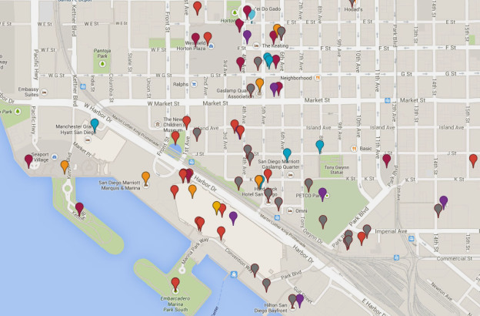
Product Backlog - User Stories & Acceptance Criteria
As a consumer, I can choose to watch events, so that I can be automatically contacted of changes to those events
I can ‘watch’ events
I can receive emails of changes to events I’m watching
As an Organizer, I can edit my existing events, so that I may provide new information
I can edit my event after it has been created.
I can automatically inform users watching my event of changes to the event information
As an Admin, I can add, view, edit, and delete events, so that I can oversee what events are being posted
I can create new events
I can view recently created events
I can change posted events to pending if the event’s authenticity comes into question
I can edit existing events
I can delete events
As an Admin, I can authenticate and unauthenticate organizer accounts, to control who can post events without individual authentication
I can authenticate an organizer account
An authenticated organizer can post events without individual authentication
I can unauthenticate an organizer account
Notes:
Tim

Slide 6
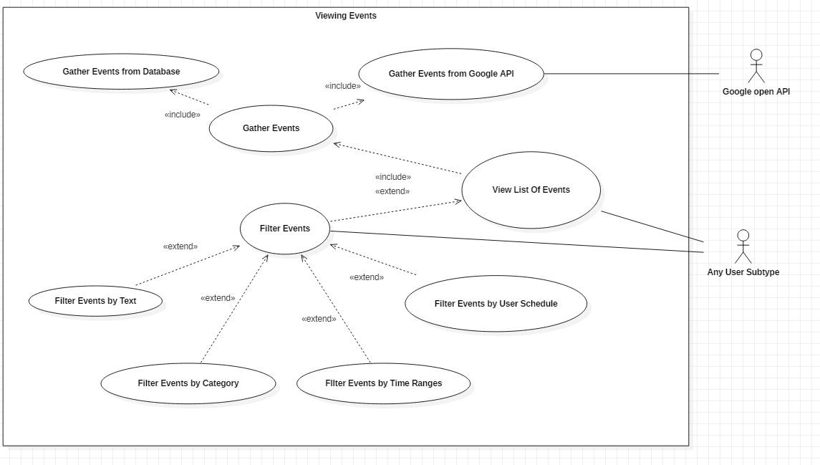
Use Cases - Viewing Events

Slide 7
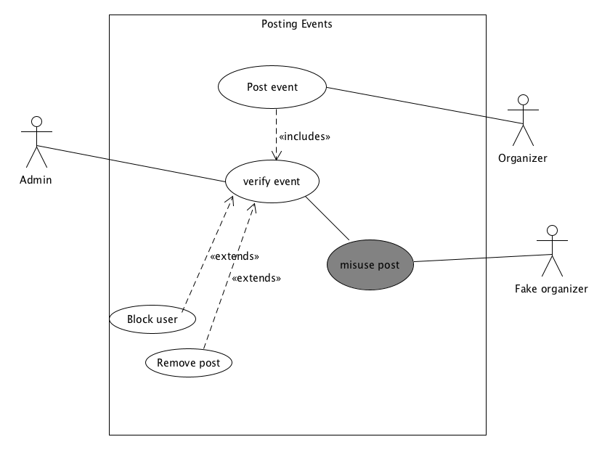
Use Cases - Posting Events
Notes:
Gabriel

Slide 8
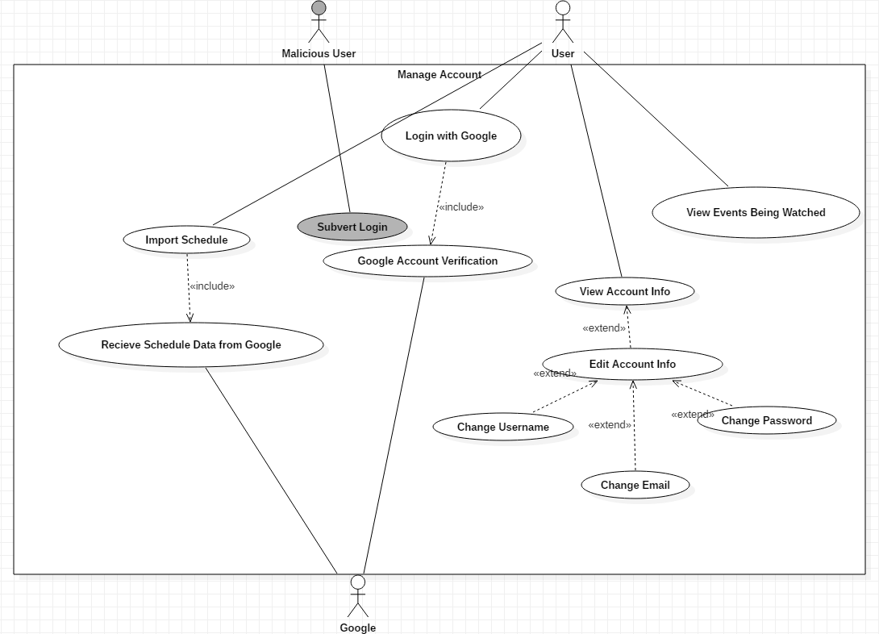
Use Cases - Managing Account

Slide 9

Security and Safety Requirements
Consumers shall not be able to view the calendars, schedules, and event logs of other users.
Organizers shall not be able to modify the details of events posted by other organizers.
Nobody will not be able to impersonate or act as another organizer or consumer
Organizers and users shall not post harmful or hurtful content or events
Notes:
Kevin

Slide 10

Risk-Driven Specifications + Break down to 4 steps
The system shall salt passwords being passed between parts of the system to ensure their plaintext value can’t be viewed at any point.
Risk Identification: Hackers get information and access to accounts they should not be able to.
Risk Analysis: Our passwords must be stored safely in our database
Risk Decomposition: Our passwords are stored as plaintext (at first).
Risk Reduction: Salt those passwords!
Admins shall authenticate postings so criminals/predators cannot create events with the intention of harassing or harming people.
Risk Identification: Predatory or criminal consumers can create events with the intention of harassing or harming the people that attend.
Risk Analysis: Events created with malicious intent must be filtered.
Risk Decomposition: The postings have no form of verification for authenticity.
Risk Reduction: Have admins authenticate postings to verify legitimate events.
Notes:
Michael

Slide 11
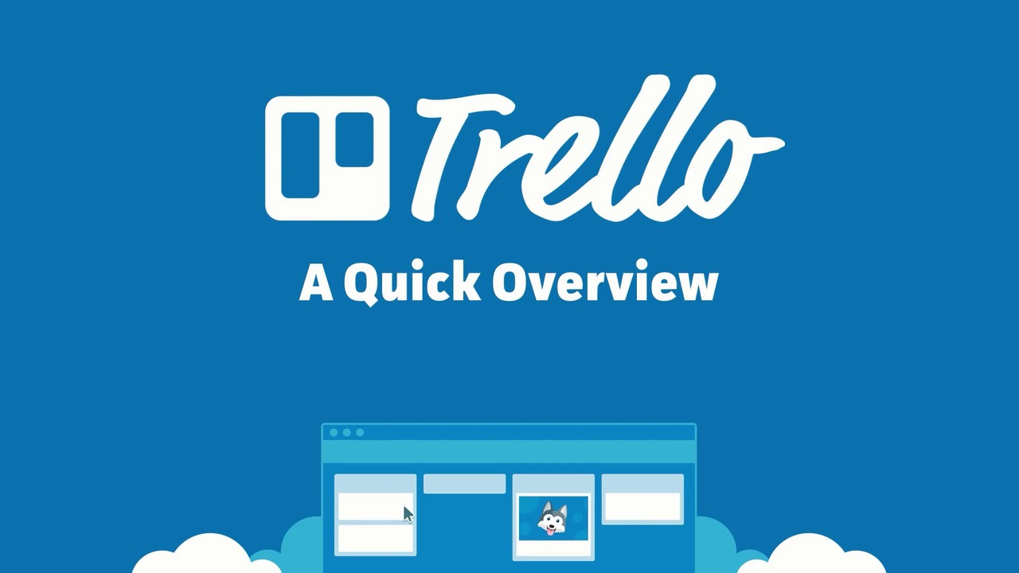
Notes:
Nick

Slide 12

Who did what? What worked well?
Our group has been meeting regularly during lab hours to work on this project. During these lab hours, our group has worked to develop User requirements, as well as other aspects for our web application we wish to design. Everyone in the group has played an active role in developing user requirements, use cases, etc. and the results of each lab are posted to a shared folder on Google Drive. So far, this approach has proved to be an effective one.
Notes:
Gabriel

Slide 13


